Slide 1
Making Meaning Out of Your Money: Finance Fun for All!
CapCONNECT
Andrea Mills, CPA, MBA, CCSA®, CGMA
Principal

Slide 2
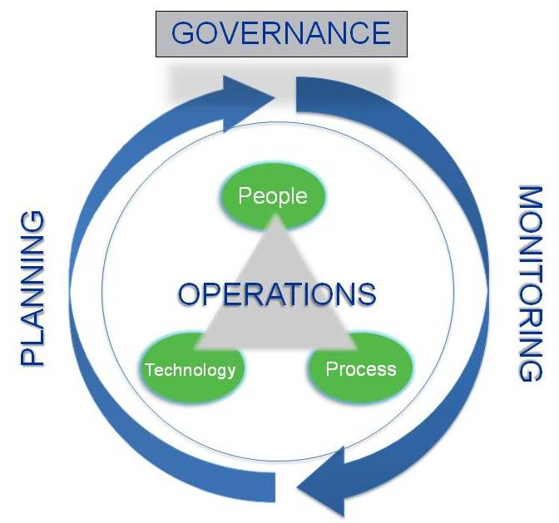
Strategic Financial Management
www.strongnonprofits.org

Slide 3
Excellence in Financial Management
What does excellence in financial management look like?
Organizations engage in effective financial planning to prioritize the use of resources
Leaders closely monitor results to understand how the organization is doing in relation to plans and to adjust accordingly
Effective financial operations ensure that plans are being executed properly and that decisions are based on reliable information
Governance sees that all of these elements are being carried out properly and in furtherance of the organization’s mission

Slide 4
Fiscal strategy: Long Term Sustainability

Slide 5
Elements of Long Term Sustainability
Two Key Elements of Long-term Sustainability
(1) Creating annual and long-term financial goals and plans
(2) Establishing mechanisms to monitor financial performance

Slide 6
Elements of Long Term Sustainability
(1) Creating annual and long-term financial goals and plans
Develop multi-year financial plans
Establish operating reserves and policies on their use
Understand the full costs of programming
Incorporate scenario planning
Plan for capital needs, including both operating cash flow and fixed asset investments

Slide 7
Elements of Long Term Sustainability
(2) Establishing mechanisms to monitor financial performance
Set Key Performance Indicators
Develop performance dashboards
Incorporate forecasting

Slide 8
Key Financial Metric: Operating Reserves

Slide 9
Balance Sheet
What We Own
Cash
Receivables
Investments
Property, Plant & Equipment, net
ASSETS
LIABILITIES
What We Owe
Bills due
Line of Credit
Deferred Revenue
Long-term Debt
=
+
NET ASSETS
Our Available Capital
Unrestricted
Board Designated
Fixed Assets
Other
Temp. Restricted
Perm. Restricted

Slide 10
Capital Structure
LUNA / Working Capital
Short-term
Liquid Capital
Debt Repayment
Longer-term
Reserves
(may be board designated)
ACCESSIBILITY
Facility Reserve
Growth & Innovation
Temp. Restricted Net Assets*
Donor restricted
capital
Endowment**
*To be accessed only if delivering on donor expectations
**Only earnings are accessible

Slide 13
Balance Sheet: Operating Reserves
Liquid Unrestricted Net Assets (LUNA)
The portion of unrestricted net assets that could be converted to cash relatively easily (may or may not include board designated funds, based on accessibility)
Funds available for purposes such as supplying working capital, guarding against downturns, and pursuing new opportunities
LUNA = Unrestricted Net Assets – (Fixed Assets – Mortgages)
Benchmark: LUNA sufficient to cover 3-6 months of operating expenses is generally considered healthy, but this depends on an organization’s business model, plans, and goals.

Slide 14
Activity
LUNA / Composition of Net Assets

Slide 15
Strategies for Creating Reserves
How Are They Funded ?
Reserves
Annual Surplus Designation
Budgetary Line Item for Annual Replenishment
Re-designation of Special Purpose Funds
Targeted Foundation Investment

Slide 16
Creating annual and long-term financial plans

Slide 17
Types of Budgets
Type | Description
Strategic Budget | 3-5 year plan for revenues and expenses, encompassing an organization’s strategic goals.
Operating Budget | 1-year plan for revenues and expenses that includes the departments and programs of an organization and may incorporate plans for accumulation of reserves.
Cash Budget | 6-12 month plan for cash inflows, cash outflows, and the amount and duration of cash shortages or shortfalls.
School Budget | 1-year plan for revenue and expenses related to a specific school, with the goal of understanding true cost of delivery.
Grant Budget | A plan for specific revenue and expenses related to a grant or contract.
Capital Budget | A plan for fixed asset outlays within a 1-5 year period.

Slide 18
Multi-Year Planning
Why create multi-year plans?
Facilitates the integration of operational and strategic planning
Provides a forum to address significant long-term issues
Creates a space for planning around multi-year grants
Increases focus on long-term financial sustainability

Slide 19
Strategic and Financial Planning
How do strategic and financial planning interact?
Strategy gets at the set of actions required to achieve desired goals
Financial planning forces the focus on the “how”– e.g. relevant operational decisions
Resource decisions, in turn, reality-test the strategic plan, and allow for further refinement

Slide 20
What does budgeting for the “full cost” of programs mean to you?

Slide 21
Budgeting Concepts: Expense Categories
Natural and Functional Expenses
Natural Expenses
Functional Expenses
Expenses classified by the nature of the expense:
Salaries
Rent
Utilities
Supplies
Expenses classified by the type of activity for which the expense was incurred:
Programs
Management and general
Fundraising

Slide 22
Budgeting Concepts: Expense Categories
Specific and Shared Expenses
Specific Expenses
Expenses that can be specifically assigned to one or more program(s) or function(s), based on time or money spent directly in each program or function
Salaries for program personnel
Salaries for fiscal staff
Fundraising expenses
Shared Expenses
Expenses that are shared among some or all programs and functions. These expenses must be allocated among functional areas on the basis of an appropriate methodology
Rent & utilities in a common space
Office supplies
Depreciation

Slide 23
Understanding Full Cost of Programming
Funders and contracts are often more likely to fund “Tier 1” expenses than “Tier 2,” and “Tier 2” than “Tier 3”
TIER 1
Specific Program
Expenses
TIER 2
Shared Program
Expenses
TIER 3
Management & General
and Fundraising Expenses
(“Overhead”)

Slide 24
Translating Cost Categories
How we see our costs
How funders see our costs
Tier 1
Tier 3
Tier 2
Program
Indirect
Specific Program Expenses
Shared Program
Expenses
“Overhead”

Slide 25
Allocation Methodology
Allocation Methodology
Definition
A method by which costs associated with more than one program or support area (administrative or fundraising) are distributed across functions.
Purpose
To allocate expenses in order to determine the true costs of programs and cost per unit of services

Slide 26
Building Your Budget
Staff Level of Effort: FTE Calculations

Slide 27
Building Your Budget
Personnel: Salaries
Tier 1: Specific Program Expenses
Tier 3: Specific M&G and Fundraising expenses

Slide 28
Building Your Budget
Personnel: Salaries + Fringe

Slide 29
Building Your Budget
Tiers 1 & 3: Specific Expenses
Tier 1: Specific Program Expenses
Tier 3: Specific M&G and Fundraising Expenses

Slide 30
Building Your Budget
Tiers 2 & 3: Shared Expenses
Percentages derived using staff level of effort calculation
Tier 2: Shared
Costs Allocated to Programs
Tier 3: Shared Costs Allocated to M&G and Fundraising

Slide 31
Building Your Budget
Tier 1 +2: Specific and Shared Expenses
for Program A
Specific Program Expense
Total: $154,280
Shared Expenses Allocated to Program
Total: $23,664

Slide 32
Building Your Budget
Tier 3: Supporting Services (Overhead)
Specific M&G and Fundraising Expenses
Shared Expenses Allocated to M&G and Fundraising

Slide 33
Bringing Together Tiers 1, 2, and 3
Tier 3: “Overhead”
Tier 1: Specific Program Expense
Tier 2: Shared
Costs Allocated to Programs

Slide 34
Revenue and Expenses by Program
Surplus/Deficit
By Program

Slide 35
Strategy for Funding the Gap
Examples
Raise unrestricted dollars
Indirect cost recovery
Develop an earned revenue stream the covers the full cost of the associated program or more
Build an overhead rate into requests for restricted program funding

Slide 36
Budgeting Framework
Program-Based Budget Builder
www.strongnonprofits.org

Slide 37
Monitoring your financial plans

Slide 38
Team Decision Making
Plans for and classifies contributions
Development
Sets the financial strategy and direction for the organization in collaboration with the Board
Chief
Executive
Officer
Finance
Program
Provides relevant, timely, and accurate financial data to facilitate decision-making
Clarifies services and programming and what drives expenses

Slide 39
Financial Decision-Making Meetings
Executive, Program, Operations, and Development Managers should meet monthly or quarterly with Fiscal staff
Topics for discussion
Budget-to-Actual Variances
Rate of spending on contracts
Anticipated future spending/cost control
Completion of activities funded by restricted grants

Slide 40
Financial Monitoring
Who Should Receive Financial Reports?
Monthly |  | Quarterly
Program Managers | Executive Director | Board of Directors
Budget-to-actual revenue & expenses for the program(s) they oversee Performance Dashboards | Budget-to-actual revenue & expenses for (a) each program (b) organization-wide Balance sheet Year-end Forecast Cash flow projection Performance Dashboards | Management narrative Budget-to-actual revenue & expenses for (a) each program (b) organization-wide Balance sheet Year-end Forecast Cash flow projection Performance Dashboards

Slide 41
Adding a Performance Dashboard creates Focus
A Performance Dashboard complements your other financial reports without replacing them
Management Narrative
Balance Sheet
Cash Flow Projections
Year-end Projections
Budget vs. Actuals
Performance Dashboard

Slide 42
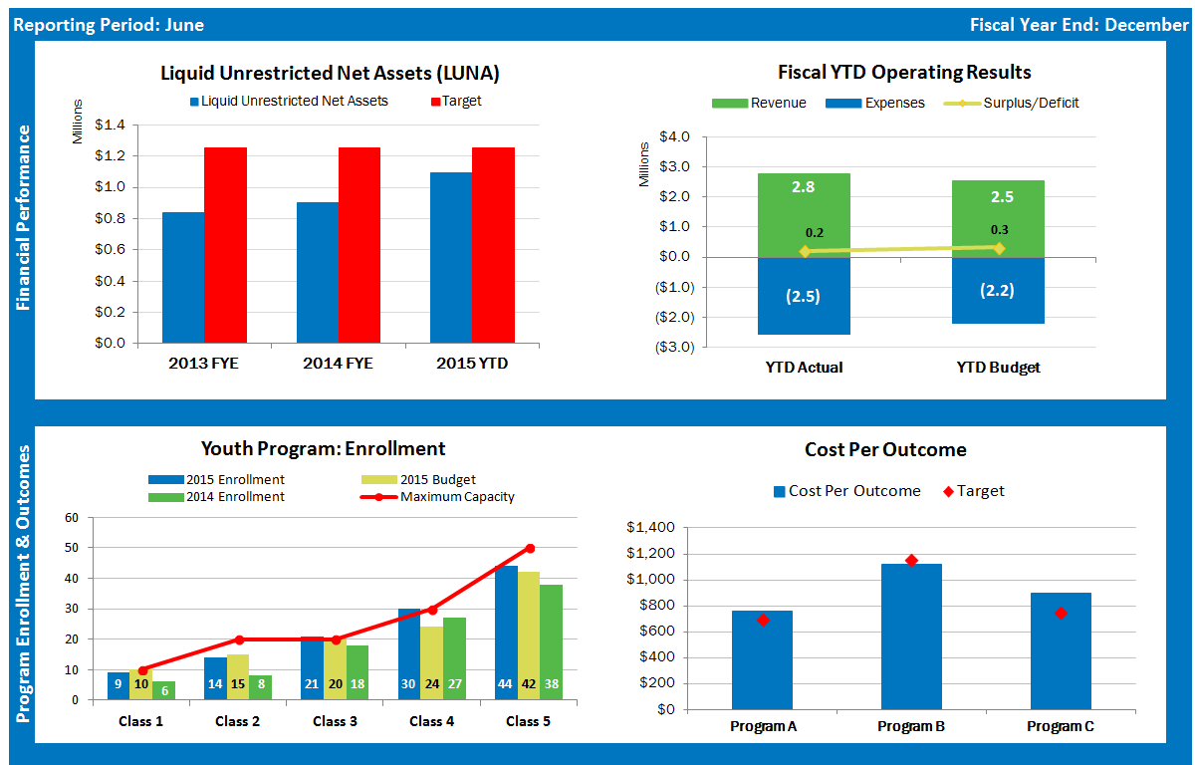
Performance Dashboard: Sample 1

Slide 43
Performance Dashboard: Sample 2

Slide 44
Resources

Slide 45
Resources
The Key to Long Term Financial Health Liquid Unrestricted Net Assets (LUNA), Hilda Polanco, New York Nonprofit Press, May 2012: http://www.nynp.biz/index.php/strengthening-nonprofits/10505-the-key-to-long-term-financial-health-liquid-unrestricted-net-assets-luna-
Maintaining Nonprofit Operating Reserves: A Whitepaper, by the Nonprofit Operating Reserves Initiative Workgroup, December 2008 http://www.nccs2.org/wiki/images/3/3c/OperatingReservesWhitePaper2009.pdf
Getting Your Nonprofit Budget Past “One Day (or Year) at a Time,” Hilda Polanco, The Dodge Blog, May 2016: http://blog.grdodge.org/2016/05/03/technical-assistance-getting-your-nonprofit-budget-past-one-day-or-year-at-a-time/#sthash.viu7dSrc.dpbs

Slide 46
Resources: Webinars
Nonprofit Quarterly & FMA
Ensuring the Right Mix of Financial Reports for Your Board
Models and Components of Great Nonprofit Dashboards
http://info.nonprofitquarterly.org/webinar-understanding-financial-models-board-guidance
https://nonprofitquarterly.org/2016/02/17/models-and-components-of-a-great-nonprofit-dashboard/

Slide 47
Strongnonprofits.org
StrongNonprofits.org
In collaboration with the Wallace Foundation, FMA has created a library of tools and resources to help organizations become “fiscally fit”
Four Topic Areas: Planning | Monitoring | Operations | Governance

Slide 48
Questions?

Slide 49
Fiscal Management Associates, LLC
Established in 1999 to serve not-for-profit organizations around the country
Provides customized financial management, accounting, software, organizational development, human resources, and other consulting services
Works directly with organizations or through funder-supported management and technical assistance programs
FMA's mission is to empower not-for-profit organizations with the knowledge and skills to successfully serve their constituents and fulfill their missions
Andrea Mills, MBA, CPA, CCSA®, CGMA
amills@fmaonline.net
212-931-9163
New York | Chicago | Oakland | LA
@FMA4Nonprofits
/FiscalManagementAssociates
www.fmaonline.net
linkedin.com/company/fiscal-management-associates-llc

